Slide 1

CARC103 – Computer Architecture
Kent Institute Australia Pty. Ltd.
ABN 49 003 577 302 CRICOS Code: 00161E RTO Code: 90458 TEQSA Provider Number: PRV12051

Slide 2
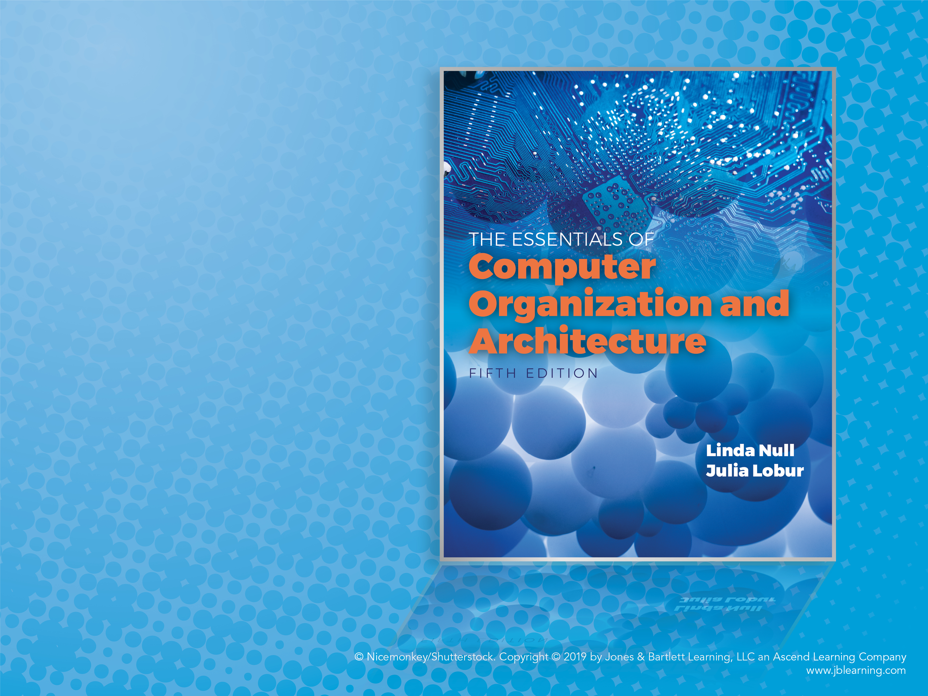
Chapter 1
Introduction

Slide 3
Objectives
Know the difference between computer organization and computer architecture.
Understand units of measure common to computer systems.
Understand the computer as a layered system.
Be able to explain the von Neumann architecture and the function of basic computer components.
Notes:
কম্পিউটার সংগঠন এবং কম্পিউটার আর্কিটেকচারের মধ্যে পার্থক্য জানুন।
কম্পিউটার সিস্টেমে সাধারণ পরিমাপের এককগুলি বুঝুন।
কম্পিউটারকে একটি স্তরযুক্ত সিস্টেম হিসাবে বুঝুন।
ভন নিউম্যান আর্কিটেকচার এবং কম্পিউটারের মৌলিক উপাদানগুলির কাজ ব্যাখ্যা করতে সক্ষম হন।

Slide 4
Overview
Why study computer organization and architecture?
Design better programs, including system software such as compilers, operating systems, and device drivers.
Optimize program behavior.
Evaluate (benchmark) computer system performance.
Understand time, space, and price tradeoffs.
Notes:
কেন কম্পিউটার সংগঠন এবং স্থাপত্য অধ্যয়ন? সিস্টেম সফ্টওয়্যার যেমন কম্পাইলার, অপারেটিং সিস্টেম এবং ডিভাইস ড্রাইভার সহ আরও ভাল প্রোগ্রাম ডিজাইন করুন। প্রোগ্রাম আচরণ অপ্টিমাইজ করুন. মূল্যায়ন (বেঞ্চমার্ক) কম্পিউটার সিস্টেম কর্মক্ষমতা. সময়, স্থান, এবং মূল্য ট্রেডঅফ বুঝুন।

Slide 5
Overview
Computer organization
Encompasses all physical aspects of computer systems (e.g., circuit design, control signals, memory types).
How does a computer work?
Computer architecture
Logical aspects of system implementation as seen by the programmer (e.g., instruction sets, instruction formats, data types, addressing modes).
How do I design a computer?
Notes:
কম্পিউটার সংস্থা
কম্পিউটার সিস্টেমের সমস্ত শারীরিক দিক অন্তর্ভুক্ত করে (যেমন, সার্কিট ডিজাইন, নিয়ন্ত্রণ সংকেত, মেমরির ধরন)।
কিভাবে একটি কম্পিউটার কাজ করে?
কম্পিউটার আর্কিটেকচার
প্রোগ্রামার দ্বারা দেখা সিস্টেম বাস্তবায়নের যৌক্তিক দিক (যেমন, নির্দেশ সেট, নির্দেশ বিন্যাস, ডেটা প্রকার, ঠিকানা মোড)।
আমি কিভাবে একটি কম্পিউটার ডিজাইন করব?

Slide 6
Computer Systems
There is no clear distinction between matters related to computer organization and matters relevant to computer architecture.
Principle of Equivalence of Hardware and Software:
Any task done by software can also be done using hardware, and any operation performed directly by hardware can be done using software.*
* Assuming speed is not a concern.
Notes:
কম্পিউটার সংস্থা সম্পর্কিত বিষয় এবং কম্পিউটার আর্কিটেকচারের সাথে প্রাসঙ্গিক বিষয়গুলির মধ্যে কোন স্পষ্ট পার্থক্য নেই।
হার্ডওয়্যার এবং সফ্টওয়্যারের সমতুলতার নীতি:
সফ্টওয়্যার দ্বারা করা যে কোনও কাজ হার্ডওয়্যার ব্যবহার করেও করা যেতে পারে, এবং হার্ডওয়্যার দ্বারা সঞ্চালিত যে কোনও কাজ সফ্টওয়্যার ব্যবহার করে করা যেতে পারে।*
গতি অনুমান একটি উদ্বেগ নয়.

Slide 7
Computer Systems
At the most basic level, a computer is a device consisting of three pieces:
A processor to interpret and execute programs
A memory to store both data and programs
A mechanism for transferring data to and from the outside world
Notes:
সবচেয়ে মৌলিক স্তরে, একটি কম্পিউটার হল একটি ডিভাইস যা তিনটি অংশ নিয়ে গঠিত:
প্রোগ্রাম ব্যাখ্যা এবং চালানোর জন্য একটি প্রসেসর
ডেটা এবং প্রোগ্রাম উভয়ই সঞ্চয় করার জন্য একটি মেমরি
বহির্বিশ্বে এবং থেকে ডেটা স্থানান্তর করার জন্য একটি প্রক্রিয়া

Slide 8
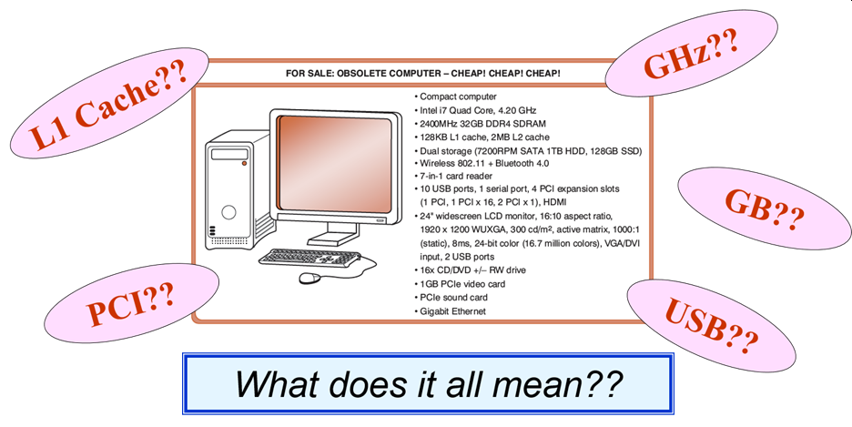
An Example System
Consider this advertisement:

Slide 9
An Example System
Measures of capacity and speed:
Kilo- (K) = 1 thousand = 10³ and 2¹⁰
Mega- (M) = 1 million = 10⁶ and 2²⁰
Giga- (G) = 1 billion = 10⁹ and 2³⁰
Tera- (T) = 1 trillion = 10¹² and 2⁴⁰
Peta- (P) = 1 quadrillion = 10¹⁵ and 2⁵⁰
Exa- (E) = 1 quintillion = 10¹⁸ and 2⁶⁰
Zetta- (Z) = 1 sextillion = 10²¹ and 2⁷⁰
Yotta- (Y) = 1 septillion = 10²⁴ and 2⁸⁰
Whether a metric refers to a power of ten or a power of two typically depends upon what is being measured.

Slide 10
An Example System
Hertz = clock cycles per second (frequency)
1MHz = 1,000,000Hz
Processor speeds are measured in MHz or GHz.
Byte = a unit of storage
1KB = 2¹⁰ = 1024 Bytes
1MB = 2²⁰ = 1,048,576 Bytes
1GB = 2³⁰ = 1,099,511,627,776 Bytes
Main memory (RAM) is measured in GB.
Disk storage is measured in GB for small systems, TB (2⁴⁰) for large systems.

Slide 11
হার্টজ = ঘড়ি চক্র প্রতি সেকেন্ড (ফ্রিকোয়েন্সি)
1MHz = 1,000,000Hz
প্রসেসরের গতি MHz বা GHz এ পরিমাপ করা হয়।
বাইট = স্টোরেজের একক
1KB = 210 = 1024 বাইট
1MB = 220 = 1,048,576 বাইট
1GB = 230 = 1,099,511,627,776 বাইট
প্রধান মেমরি (RAM) GB এ পরিমাপ করা হয়।
ডিস্ক স্টোরেজ ছোট সিস্টেমের জন্য GB, বড় সিস্টেমের জন্য TB (240) পরিমাপ করা হয়।

Slide 12
An Example System
Measures of time and space:
Milli- (m) = 1 thousandth = 10⁻³
Micro- (μ) = 1 millionth = 10⁻⁶
Nano- (n) = 1 billionth = 10⁻⁹
Pico- (p) = 1 trillionth = 10⁻¹²
Femto- (f) = 1 quadrillionth = 10⁻¹⁵
Atto- (a) = 1 quintillionth = 10⁻¹⁸
Zepto- (z) = 1 sextillionth = 10⁻²¹
Yocto- (y) = 1 septillionth = 10⁻²⁴

Slide 14
An Example System
Millisecond = 1 thousandth of a second
Hard disk drive access times are often 10 to 20 milliseconds.
Nanosecond = 1 billionth of a second
Main memory access times are often 50 to 70 nanoseconds.
Micron (micrometer) = 1 millionth of a meter
Circuits on computer chips are measured in microns.

Slide 15
মিলিসেকেন্ড = এক সেকেন্ডের 1 হাজারতম
হার্ড ডিস্ক ড্রাইভ অ্যাক্সেসের সময় প্রায়ই 10 থেকে 20 মিলিসেকেন্ড।
ন্যানোসেকেন্ড = এক সেকেন্ডের 1 বিলিয়নতম
প্রধান মেমরি অ্যাক্সেসের সময় প্রায়ই 50 থেকে 70 ন্যানোসেকেন্ড।
মাইক্রোন (মাইক্রোমিটার) = এক মিটারের 1 মিলিয়নতম
কম্পিউটার চিপগুলিতে সার্কিটগুলি মাইক্রনে পরিমাপ করা হয়।

Slide 16
An Example System
We note that cycle time is the reciprocal of clock frequency.
A bus operating at 133MHz has a cycle time of 7.52 nanoseconds:
133,000,000 cycles/second = 7.52 ns/cycle

Slide 17
Standards Organizations
There are many organizations that set computer hardware standards—to include the interoperability of computer components.
Throughout this book, and in your career, you will encounter many of them.
Some of the most important standards-setting groups include the following.

Slide 18
Standards Organizations
The Institute of Electrical and Electronic Engineers (IEEE)
Promotes the interests of the worldwide electrical engineering community.
Establishes standards for computer components, data representation, and signaling protocols, among many other things.

Slide 19
Standards Organizations
The International Telecommunications Union (ITU)
Concerns itself with the interoperability of telecommunications systems, including data communications and telephony.
National groups establish standards within their respective countries:
The American National Standards Institute (ANSI)
The British Standards Institution (BSI)

Slide 20
Standards Organizations
The International Organization for Standardization (ISO)
Establishes worldwide standards for everything from screw threads to photographic film.
Is influential in formulating standards for computer hardware and software, including their methods of manufacture.
Note: ISO is not an acronym. ISO comes from the Greek,
isos, meaning “equal.”

Slide 21
The Computer Level Hierarchy
Computers consist of many things besides chips.
Before a computer can do anything worthwhile, it must also use software.
Writing complex programs requires a “divide and conquer” approach, where each program module solves a smaller problem.
Complex computer systems employ a similar technique through a series of virtual machine layers.

Slide 22
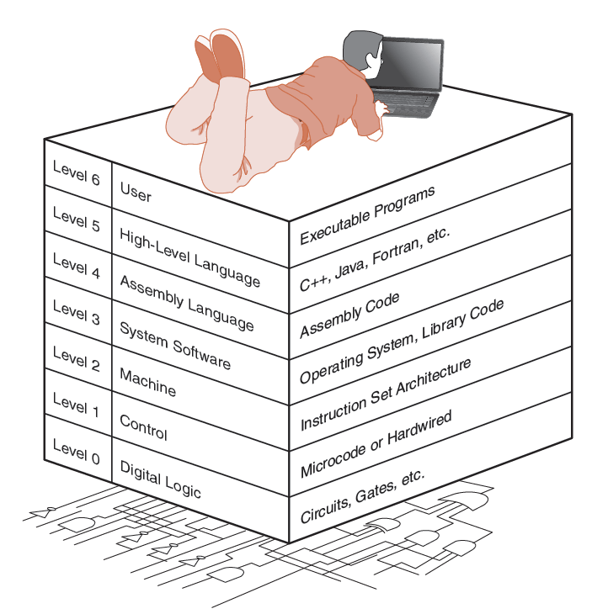
The Computer Level Hierarchy
Each virtual machine layer is an abstraction of the level below it.
The machines at each level execute their own particular instructions, calling upon machines at lower levels to perform tasks as required.
Computer circuits ultimately carry out the work.

Slide 23
The Computer Level Hierarchy
Level 6: The User Level
Program execution and user interface level
The level with which we are most familiar
Level 5: High-Level Language Level
The level with which we interact when we write programs in languages such as C, Pascal, Lisp, and Java.

Slide 24
The Computer Level Hierarchy
Level 4: Assembly Language Level
Acts upon assembly language produced from Level 5, as well as instructions programmed directly at this level.
Level 3: System Software Level
Controls executing processes on the system.
Protects system resources.
Assembly language instructions often pass through Level 3 without modification.

Slide 25
The Computer Level Hierarchy
Level 2: Machine Level
Also known as the Instruction Set Architecture (ISA) Level.
Consists of instructions that are particular to the architecture of the machine.
Programs written in machine language need no compilers, interpreters, or assemblers.

Slide 26
The Computer Level Hierarchy
Level 1: Control Level
A control unit decodes and executes instructions and moves data through the system.
Control units can be microprogrammed or hardwired.
A microprogram is a program written in a low-level language that is implemented by the hardware.
Hardwired control units consist of hardware that directly executes machine instructions.

Slide 27
The Computer Level Hierarchy
Level 0: Digital Logic Level
This level is where we find digital circuits (the chips).
Digital circuits consist of gates and wires.
These components implement the mathematical logic of all other levels.

Slide 28
Cloud Computing: Computing as a Service
The ultimate aim of every computer system is to deliver functionality to its users.
Computer users typically do not care about terabytes of storage and gigahertz of processor speed.
Many companies outsource their data centers to third-party specialists, who agree to provide computing services for a fee.
These arrangements are managed through service-level agreements (SLAs).

Slide 29
Cloud Computing: Computing as a Service
Rather than pay a third party to run a company-owned data center, another approach is to buy computing services from someone else’s data center and connect to it via the Internet.
This is the idea behind a collection of service models known as Cloud computing.
The “Cloud” is a visual metaphor traditionally used for the Internet. It is even more apt for service-defined computing.

Slide 30
Cloud Computing: Computing as a Service
Cloud computing relies on the concept of elasticity where resources can be added and removed as needed.
You pay for only what you use.
Virtualization is an enabler of elasticity.
Instead of having a physical machine, you have a “logical” machine that may span several physical machines, or occupy only part of a single physical machine.
Potential issues: Privacy, security, having someone else in control of software and hardware you use

Slide 31
Cloud Computing: Computing as a Service
More Cloud computing models:
Software as a Service, or SaaS. The consumer of this service buy application services
Well-known examples include Gmail, Dropbox, GoToMeeting, and Netflix.
Platform as a Service, or PaaS. Provides server hardware, operating systems, database services, security components, and backup and recovery services.
Well-known PaaS providers include Google App Engine and Microsoft Windows Azure Cloud Services.

Slide 32
Cloud Computing: Computing as a Service
More Cloud computing models:
Infrastructure as a Service (IaaS) provides only server hardware, secure network access to the servers, and backup and recovery services. The customer is responsible for all system software including the operating system and databases.
Well-known IaaS platforms include Amazon EC2, Google Compute Engine, Microsoft Azure Services Platform, Rackspace, and HP Cloud.
Cloud storage is a limited type of IaaS that includes services such as Dropbox, Google Drive, and Amazon.com’s Cloud Drive.

Slide 33
The von Neumann Model
On the ENIAC, all programming was done at the digital logic level.
Programming the computer involved moving plugs and wires.
A different hardware configuration was needed to solve every unique problem type.
Configuring the ENIAC to solve a “simple” problem required many days labor by skilled technicians.

Slide 34
The von Neumann Model
Inventors of the ENIAC, John Mauchley and J. Presper Eckert, conceived of a computer that could store instructions in memory.
The invention of this idea has since been ascribed to a mathematician, John von Neumann, who was a contemporary of Mauchley and Eckert.
Stored-program computers have become known as von Neumann Architecture systems.

Slide 35
The von Neumann Model
Today’s stored-program computers have the following characteristics:
Three hardware systems:
A central processing unit (CPU)
A main memory system
An I/O system
The capacity to carry out sequential instruction processing.
A single data path between the CPU and main memory.
This single path is known as the von Neumann bottleneck.

Slide 36
আজকের সঞ্চিত-প্রোগ্রাম কম্পিউটারের নিম্নলিখিত বৈশিষ্ট্য রয়েছে: তিনটি হার্ডওয়্যার সিস্টেম: একটি কেন্দ্রীয় প্রক্রিয়াকরণ ইউনিট (CPU) একটি প্রধান মেমরি সিস্টেম একটি I/O সিস্টেম ক্রমিক নির্দেশ প্রক্রিয়াকরণের ক্ষমতা। CPU এবং প্রধান মেমরির মধ্যে একটি একক ডেটা পথ। এই একক পথটি ভন নিউম্যান বটলনেক নামে পরিচিত।

Slide 37
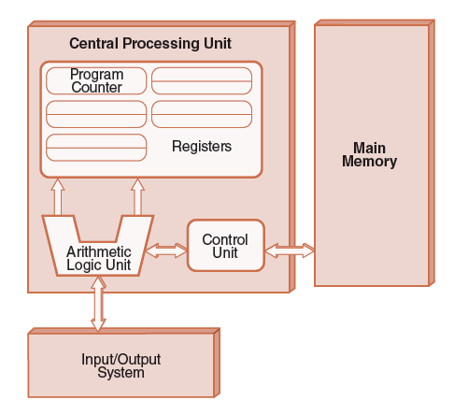
The von Neumann Model
This is a general depiction of a von Neumann system:
These computers employ a fetch-decode-execute cycle to run programs as follows . . .

Slide 38
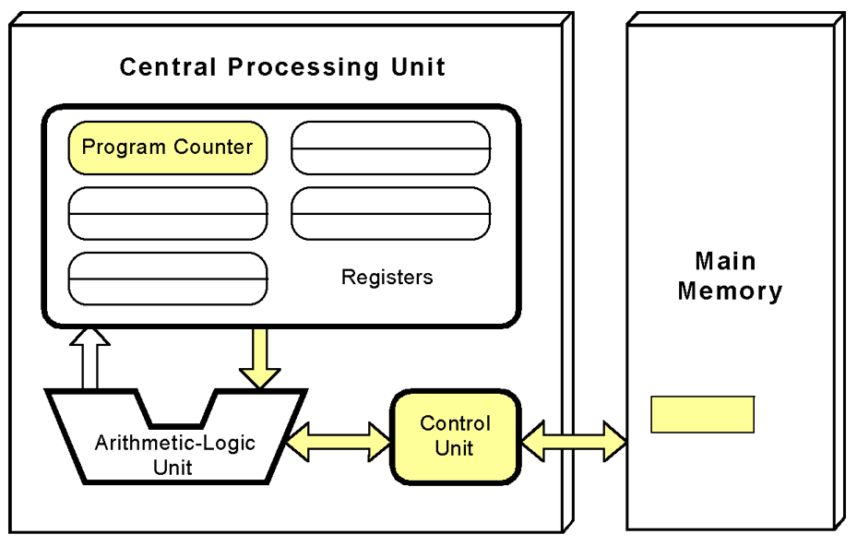
The von Neumann Model
The control unit fetches the next instruction from memory using the program counter to determine where the instruction is located.

Slide 39
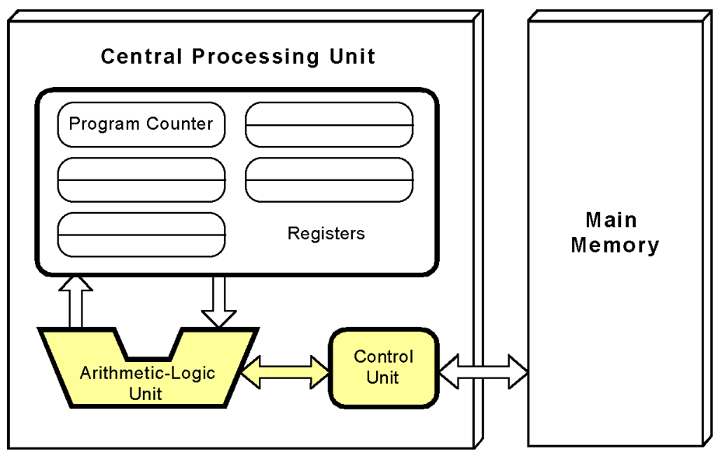
The von Neumann Model
The instruction is decoded into a language that the ALU can understand.

Slide 40
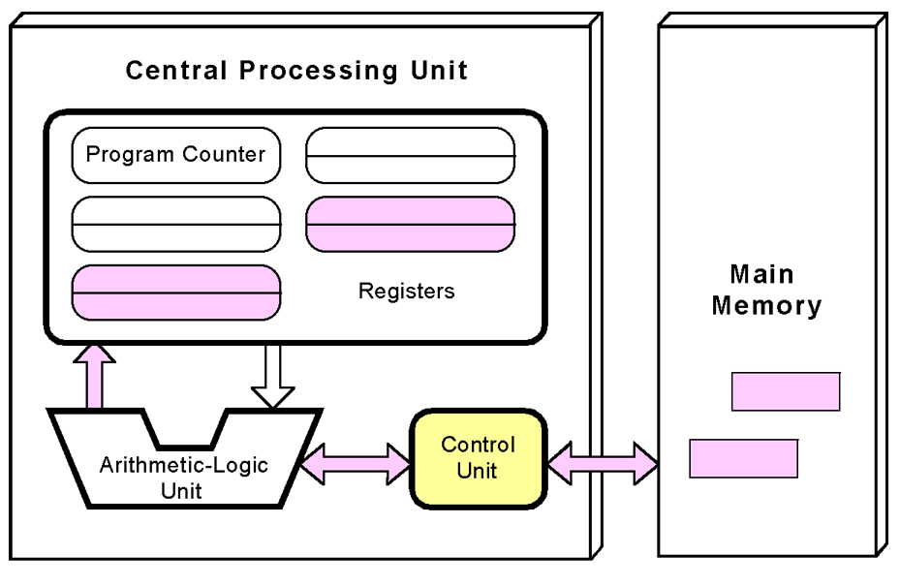
The von Neumann Model
Any data operands required to execute the instruction are fetched from memory and placed into registers within the CPU.

Slide 41
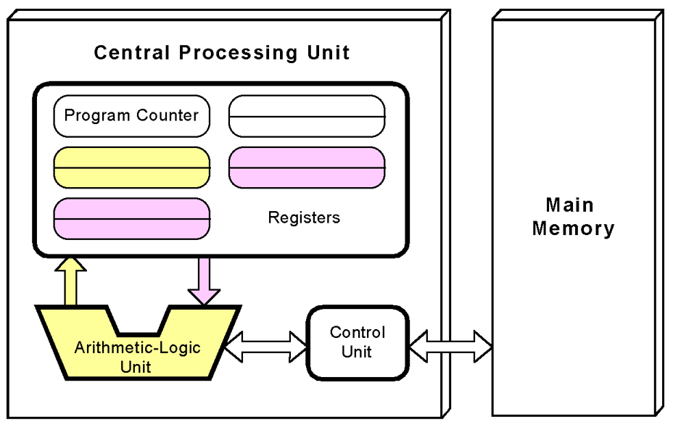
The von Neumann Model
The ALU executes the instruction and places results in registers or memory.

Slide 42
Non–von Neumann Models
Conventional stored-program computers have undergone many incremental improvements over the years.
These improvements include adding specialized buses, floating-point units, and cache memories, to name only a few.
But enormous improvements in computational power require departure from the classic von Neumann architecture.
Adding processors is one approach.

Slide 43
Non–von Neumann Models
Some of today’s systems have separate buses for data and instructions.
Called a Harvard architecture
Other non-von Neumann systems provide special-purpose processors to offload work from the main CPU.
More radical departures include dataflow computing, quantum computing, cellular automata, and parallel computing.

Slide 44
Parallel Computing
In the late 1960s, high-performance computer systems were equipped with dual processors to increase computational throughput.
In the 1970s, supercomputer systems were introduced with 32 processors.
Supercomputers with 1,000 processors were built in the 1980s.
In 1999, IBM announced its Blue Gene system containing over 1 million processors.

Slide 45
Parallel Computing
Parallel processing allows a computer to simultaneously work on subparts of a problem.
Multicore processors have two or more processor cores sharing a single die.
Each core has its own ALU and set of registers, but all processors share memory and other resources.
“Dual core” differs from “dual processor.”
Dual-processor machines, for example, have two processors, but each processor plugs into the motherboard separately.

Slide 46
Parallel Computing
Multi-core systems provide the ability to multitask (e.g., browse the Web while burning a CD).
Multithreaded applications spread mini-processes, threads, across one or more processors for increased throughput.
New programming languages are necessary to fully exploit multiprocessor power.

Slide 47
Conclusion
This chapter has given you an overview of the subject of computer architecture.
You should now be sufficiently familiar with general system structure to guide your studies throughout the remainder of this course.
Subsequent chapters will explore many of these topics in great detail.
Notes:
এই অধ্যায়টি আপনাকে কম্পিউটার স্থাপত্যের বিষয়ে একটি সংক্ষিপ্ত বিবরণ দিয়েছে।
এই কোর্সের বাকি অংশ জুড়ে আপনার অধ্যয়ন পরিচালনার জন্য আপনার এখন সাধারণ সিস্টেম কাঠামোর সাথে যথেষ্ট পরিচিত হওয়া উচিত।
পরবর্তী অধ্যায়গুলি এই বিষয়গুলির অনেকগুলি বিশদভাবে অন্বেষণ করবে।

Slide 48

kent.edu.au Kent Institute Australia Pty. Ltd. ABN 49 003 577 302 ● CRICOS Code: 00161E ● RTO Code: 90458 ● TEQSA Provider Number: PRV12051

